Slide 1

CISC-6100: Software Engineering
Week 6 -- October 7
Teaching spectrum: Grade school to Grad school
Project
Frameworks
Expectations
Getting started

Slide 2
Outline for today’s class
Review of homework
Algorithm descriptions
Activity diagrams
Semester at a glance
Interfaces (Intro)
Frameworks
Project specifics
Deliverables
Getting started
Homework
Architectures (Intro)
Team time

Slide 3
Homework Review++

Slide 4
Use of Activity Diagrams
Can your activity diagram be handed over to a (competent) programmer to be coded?
Could you readily convert your diagram into code?
Could your classmates (graduate level computer science majors) readily convert your diagram into code?
How about a recent graduate of a Python Boot Camp

Slide 5
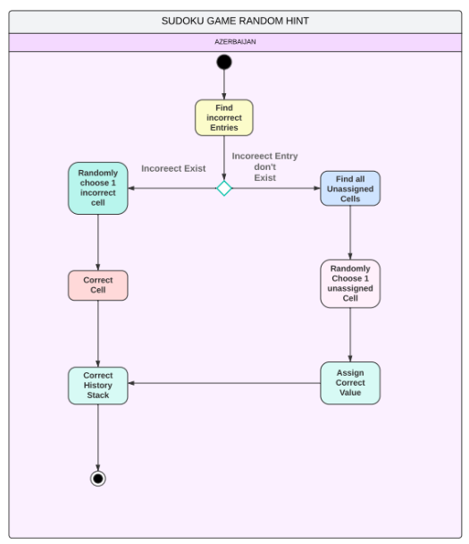
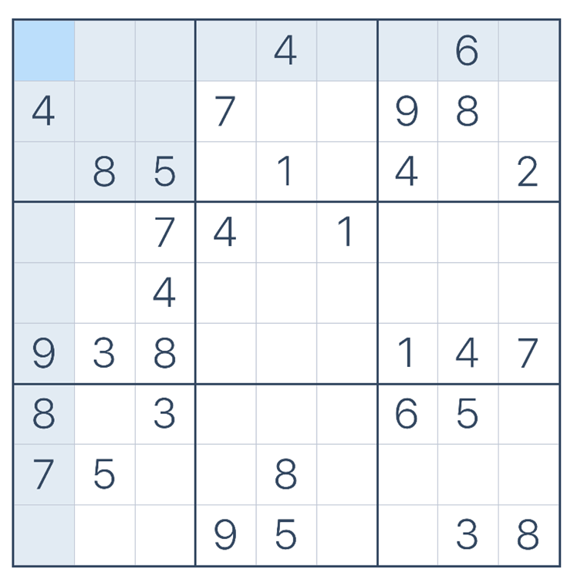
Get Random Hint
9
7
1
With incorrect cells
➔ [[0,0], [0,6], [4,3], [8,5]]
3
7
➔ [4,3]
1
7
7
With all correct cells
➔ [[0,0], [0,2], [0,3], …]
3
7
➔ [3,6]

Slide 6
Fix History Stack

Slide 7
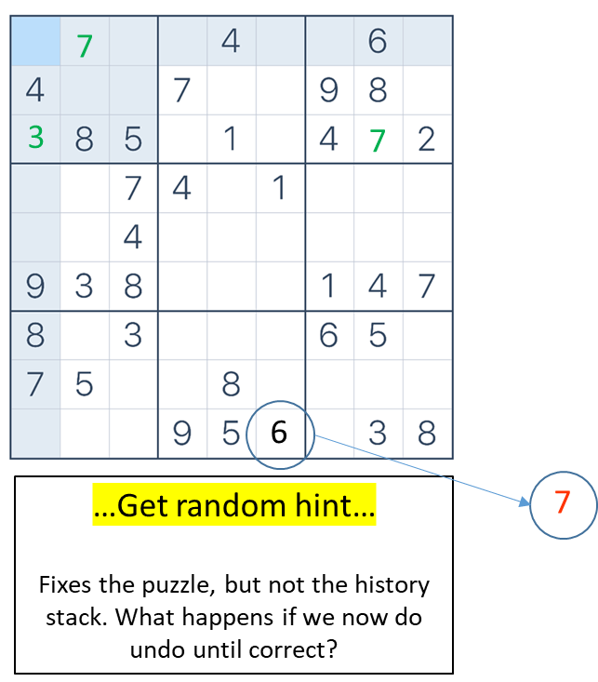
Clarification on the history representation and functionality
VS
{0,[],F,3,2,0}, F, {3,[],F,3,2,0}
{0,[],F,3,2,0}, T, {3,[],F,3,2,0}
{0,[],F,6,7,5}, F, {7,[],F,6,7,5}
{6,[],F,7,2,7}, T, {7,[],F,7,2,7}
{6,[],F,7,2,7}, T, {7,[],F,7,2,7}
{0,[],F,7,2,7}, F, {6,[],F,7,2,7}
{0,[],F,7,2,7}, F, {6,[],F,7,2,7}
{0,[],F,7,0,1}, T, {7,[],F,7,0,1}
{val, [notes], Given, col, row, ans}
{0,[],F,7,0,1}, T, {7,[],F,7,0,1}
origCell isCorrect newCell
History stack
origCell isCorrect newCell
History stack

Slide 8
Clarification on the history representation and functionality
origCell isCorrect newCell
History stack

Slide 9
Clarification on the history representation and functionality
7
{0,[],F,7,0,1}, T, {7,[],F,7,0,1}
Note: This represents the correctness of the puzzle after the move, not the correctness of the move.
origCell isCorrect newCell
History stack

Slide 10
Clarification on the history representation and functionality
7
6
{0,[],F,7,2,7}, F, {6,[],F,7,2,7}
{0,[],F,7,0,1}, T, {7,[],F,7,0,1}
origCell isCorrect newCell
History stack

Slide 11
Clarification on the history representation and functionality
7
7
{6,[],F,7,2,7}, T, {7,[],F,7,2,7}
{0,[],F,7,2,7}, F, {6,[],F,7,2,7}
{0,[],F,7,0,1}, T, {7,[],F,7,0,1}
origCell isCorrect newCell
History stack

Slide 12
Clarification on the history representation and functionality
7
7
{0,[],F,6,7,5}, F, {7,[],F,6,7,5}
{6,[],F,7,2,7}, T, {7,[],F,7,2,7}
{0,[],F,7,2,7}, F, {6,[],F,7,2,7}
7
{0,[],F,7,0,1}, T, {7,[],F,7,0,1}
origCell isCorrect newCell
History stack

Slide 13
Clarification on the history representation and functionality
7
3
7
{0,[],F,3,2,0}, F, {3,[],F,3,2,0}
{0,[],F,6,7,5}, F, {7,[],F,6,7,5}
{6,[],F,7,2,7}, T, {7,[],F,7,2,7}
{0,[],F,7,2,7}, F, {6,[],F,7,2,7}
7
{0,[],F,7,0,1}, T, {7,[],F,7,0,1}
origCell isCorrect newCell
History stack

Slide 14
Clarification on the history representation and functionality
7
3
7
{0,[],F,3,2,0}, F, {3,[],F,3,2,0}
{0,[],F,6,7,5}, F, {7,[],F,6,7,5}
{6,[],F,7,2,7}, T, {7,[],F,7,2,7}
{0,[],F,7,2,7}, F, {6,[],F,7,2,7}
6
{0,[],F,7,0,1}, T, {7,[],F,7,0,1}
…Get random hint…
Fixes the puzzle, but not the history stack. What happens if we now do undo until correct?
7
origCell isCorrect newCell
History stack

Slide 15
Leftovers: Fixing the stack after a hint
Problem reminder: After receiving a hint for a location that has already been set by the user, that location is made a hard-wired or a given location, but moves involving it can still exist on the history stack. This can cause the unwanted side-effect of an undo operation overwriting a hard-wired location.

Slide 16
Clarification on the history representation and functionality
Push
Except the cell in question
Pop
{0,[],F,3,2,0}, F, {3,[],F,3,2,0}
{0,[],F,6,7,5}, F, {7,[],F,6,7,5}
{6,[],F,7,2,7}, T, {7,[],F,7,2,7}
{0,[],F,7,2,7}, F, {6,[],F,7,2,7}
{0,[],F,7,0,1}, T, {7,[],F,7,0,1}
origCell isCorrect newCell
History stack
origCell isCorrect newCell
FixHistory stack

Slide 17
Clarification on the history representation and functionality
Push
Pop
{0,[],F,7,0,1}, T, {7,[],F,7,0,1}
{0,[],F,7,2,7}, F, {6,[],F,7,2,7}
{6,[],F,7,2,7}, T, {7,[],F,7,2,7}
{0,[],F,3,2,0}, F, {3,[],F,3,2,0}
origCell isCorrect newCell
History stack
origCell isCorrect newCell
FixHistory stack

Slide 18
Clarification on the history representation and functionality
SetCell
Pop
{0,[],F,7,0,1}, T, {7,[],F,7,0,1}
{0,[],F,7,2,7}, F, {6,[],F,7,2,7}
{6,[],F,7,2,7}, T, {7,[],F,7,2,7}
{0,[],F,3,2,0}, F, {3,[],F,3,2,0}
6
origCell isCorrect newCell
History stack
origCell isCorrect newCell
FixHistory stack

Slide 19
Clarification on the history representation and functionality
SetCell
Pop
7
3
7
{0,[],F,3,2,0}, T, {3,[],F,3,2,0}
{6,[],F,7,2,7}, T, {7,[],F,7,2,7}
{0,[],F,7,2,7}, F, {6,[],F,7,2,7}
{0,[],F,7,0,1}, T, {7,[],F,7,0,1}
6
origCell isCorrect newCell
History stack
origCell isCorrect newCell
FixHistory stack

Slide 20
Clarification on the history representation and functionality
VS
{0,[],F,3,2,0}, F, {3,[],F,3,2,0}
{0,[],F,3,2,0}, T, {3,[],F,3,2,0}
{0,[],F,6,7,5}, F, {7,[],F,6,7,5}
{6,[],F,7,2,7}, T, {7,[],F,7,2,7}
{6,[],F,7,2,7}, T, {7,[],F,7,2,7}
{0,[],F,7,2,7}, F, {6,[],F,7,2,7}
{0,[],F,7,2,7}, F, {6,[],F,7,2,7}
{0,[],F,7,0,1}, T, {7,[],F,7,0,1}
{0,[],F,7,0,1}, T, {7,[],F,7,0,1}
origCell isCorrect newCell
History stack
origCell isCorrect newCell
History stack

Slide 21
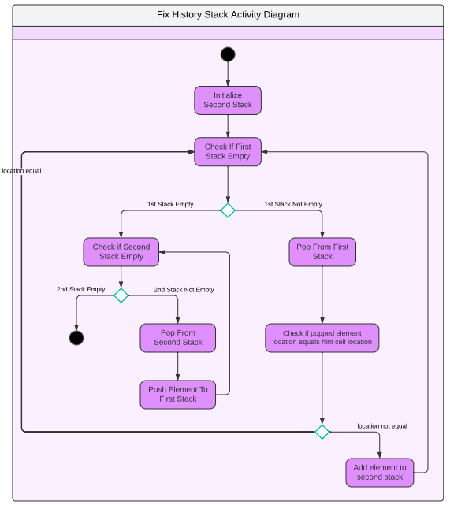
Fix History Stack

Slide 22
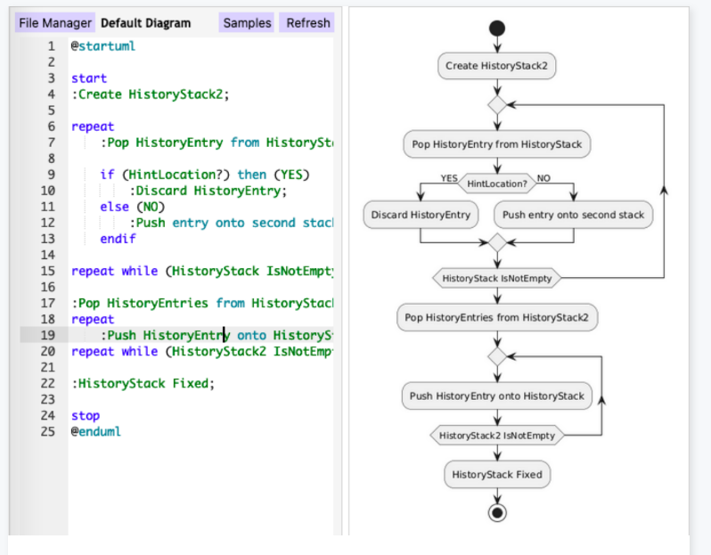
Fix History Stack
Diamonds used as merger points
Edges from decisions not labeled

Slide 23
Puzzle solving algorithms
Only needs to be run once and then stored with the puzzle.

Slide 24
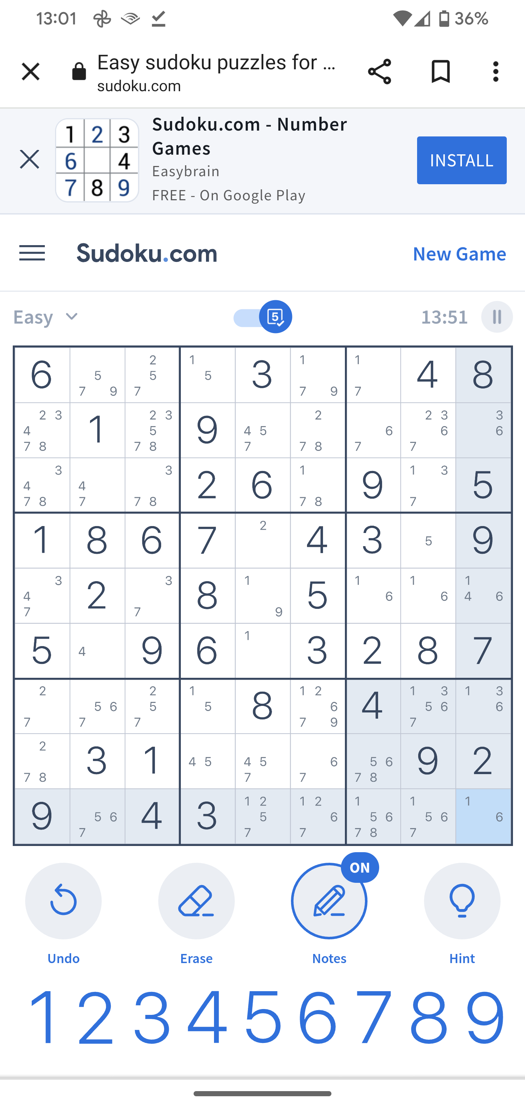
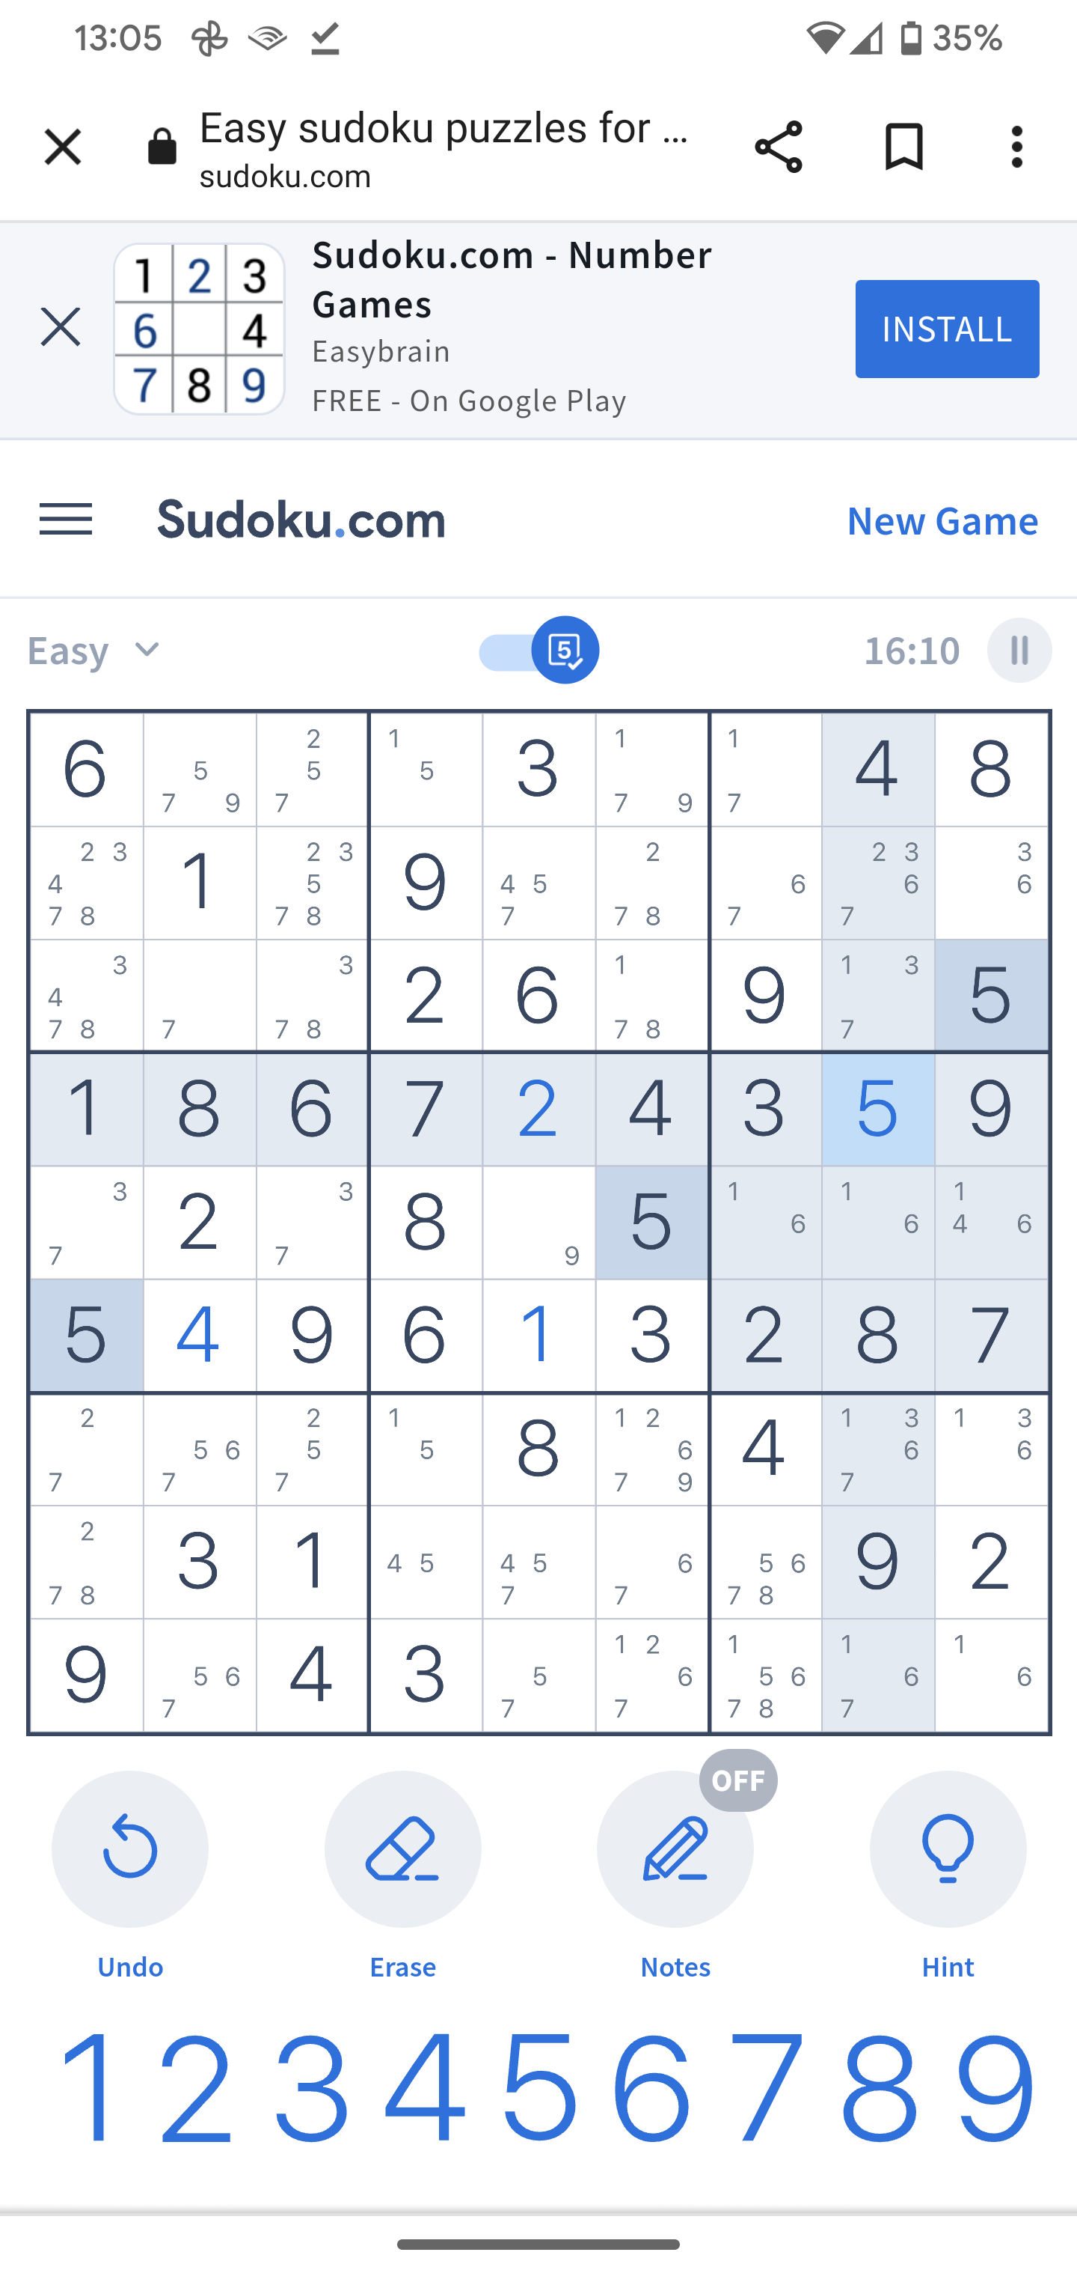
Algorithms to solve Sudoku puzzles
Easy puzzles: Can iteratively find cells that only have one possible value until the puzzle is solved

Slide 25
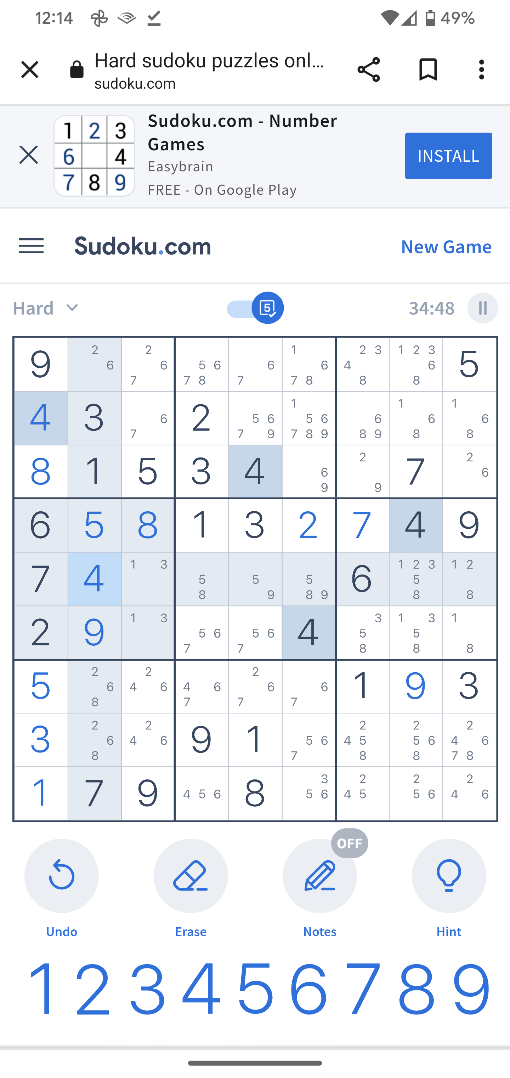
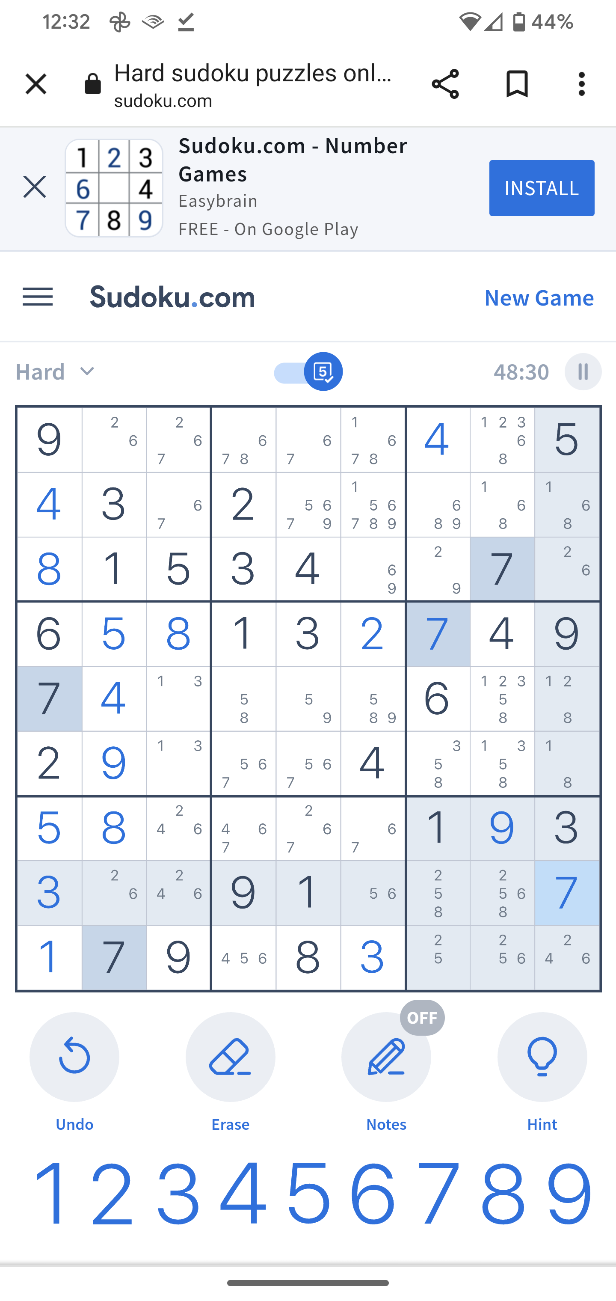
Algorithms to solve Sudoku puzzles
Medium difficulty puzzles: In combination with the ‘easy’ algorithm, can iteratively find values that occur only once in a row, column, or group until the puzzle is solved

Slide 26
Algorithms to solve Sudoku puzzles
Hard difficulty puzzles: In combination with other algorithms, look for subsets of values where the count of subsets is equal to the count of values in the union of the subsets, thereby precluding the use of those values elsewhere in the row, column, or group
X
X
X
X
X
X
X
X
X
X

Slide 27
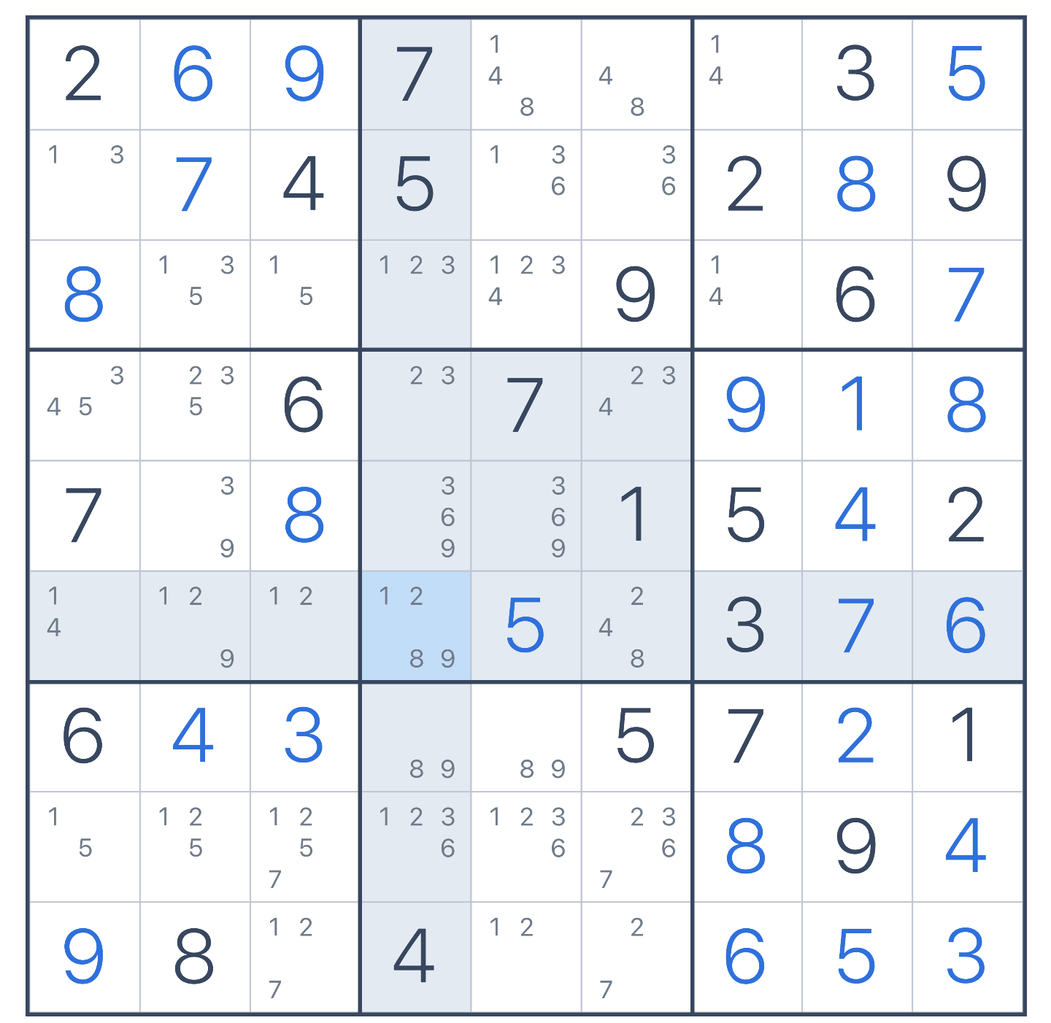
Algorithms to solve Sudoku puzzles
…
Evil / Diabolical difficulty puzzles: Iterating through the other algorithms yields getting stuck and trial and error must be used
?

Slide 28
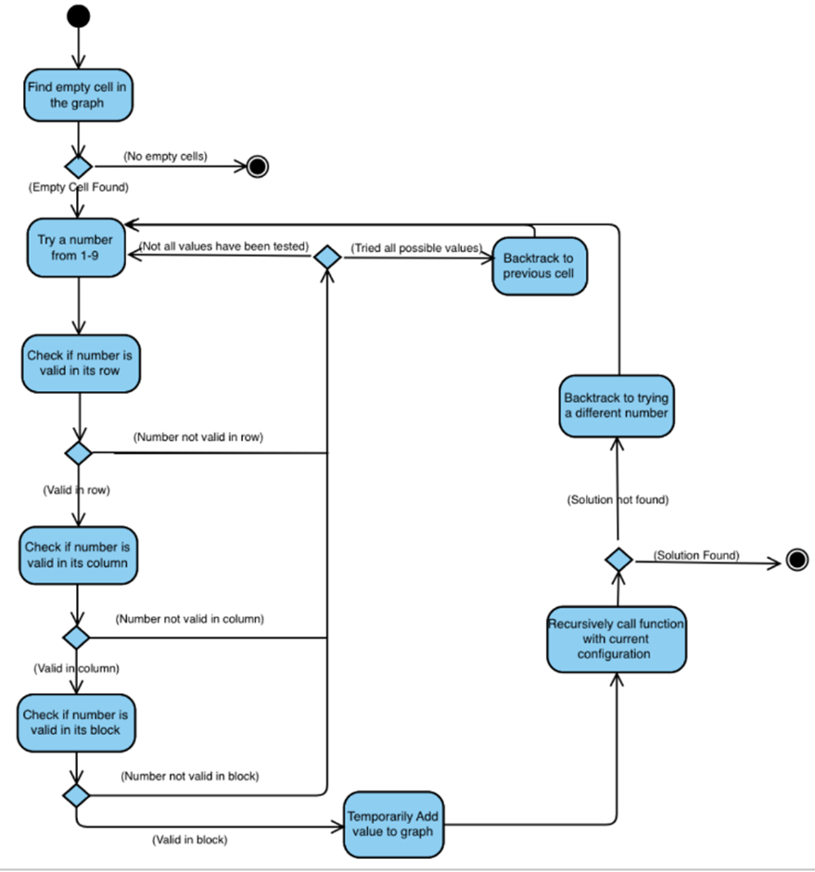
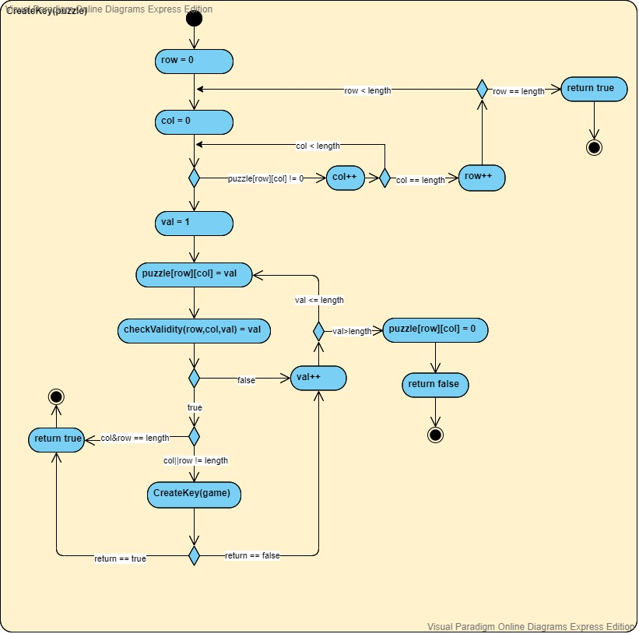
CreateKey(puzzle)
Computer creates answer key for a puzzle
Find empty cell in the graph

Slide 29
CreateKey(puzzle)
Computer creates answer key for a puzzle
Try a number from 1-9

Slide 30
CreateKey(puzzle)
Computer creates answer key for a puzzle
Check on entry’s validity

Slide 31
CreateKey(puzzle)
Computer creates answer key for a puzzle
Recursive call to this function

Slide 32
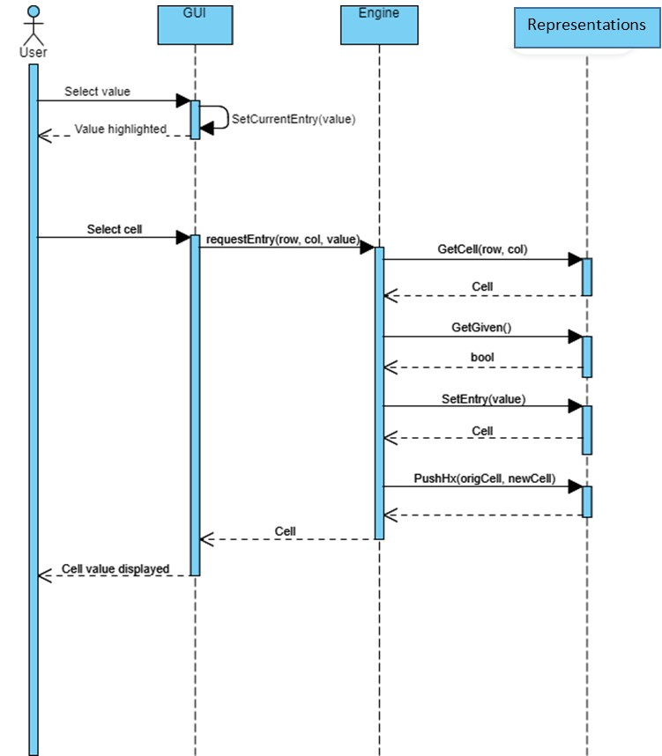
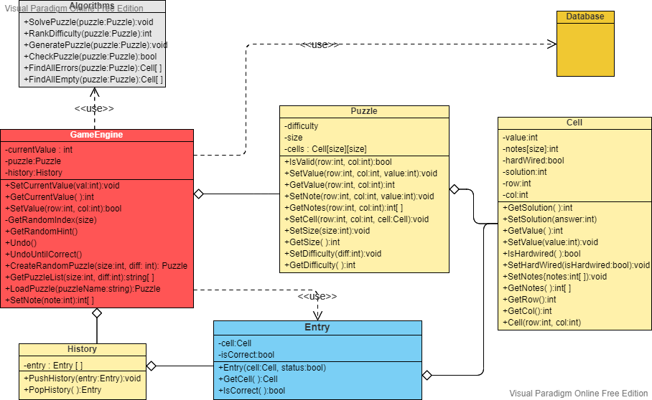
Solve puzzle
Puzzle and history representations
Set value

Slide 33
Semester at a glance

Slide 34
Outline for the semester
Week6 (today):
Architecture and Frameworks
Formal introduction to the class project
Week 7:
Process to date
Midterm practice
Week 8: Midterm
Week 9: Testing, coding
Week 10:
Front-end
Back-end
Week 11: Connectivity, Information exchange
Week 12: Design patterns
Week 13: Deployment
Week 14:
Project presentations
Final practice
Final: December 16th
Most weeks: status report by teams
Most weeks: Team time to work together in-person
Week Date
1 September 4
2 September 9
3 September 16
4 September 23
5 September 30
6 October 7
-- October 14 (No school)
7 October 21
8 October 28 -- Midterm
9 November 4
10 November 11
11 November 18
12 November 25
13 December 2
14 December 9 – Teams present project
-- December 14 – Project due
15 December 16 -- Final

Slide 35
Interfaces

Slide 36

Interfaces
Definition: In computing, an interface is a shared boundary across which two or more separate components of a computer system exchange information. https://en.wikipedia.org/wiki/Interface_(computing)
There are many different types of interfaces in computer science:
Human-machine interfaces: These include input devices (e.g., keyboard, mouse, game controller, haptic devices) and output devices (e.g., monitors, speakers, haptic devices, VR googles)
UI – User Interface
GUI – Graphical User Interface
Hardware-hardware interfaces: Can define everything from the physical connection to the syntax and semantics of the signaling (e.g., USB, HDMI, RS232, Bluetooth)
Software-hardware interfaces: Typically, the software required to control a hardware device (e.g., read/write to a disk, advance a conveyor one step)
Software-software interface: The definition by which two parts of a program (or parts of two programs) communicate with each other. This is done using well defined function calls, or in object-oriented programming, method instantiations (or URLs).
Application programming interface (API): Software-software interface that is usually specific to a program using a service of another program in the form of a library, operating system, web service, or hardware controller
(the programming construct) Interface: Code that defines a contract that all software that implements the interface must provide

Slide 37
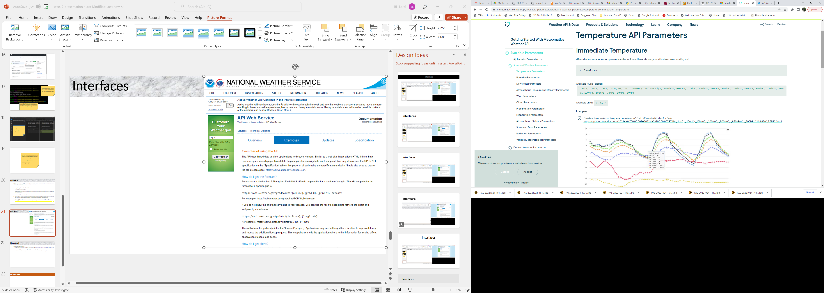
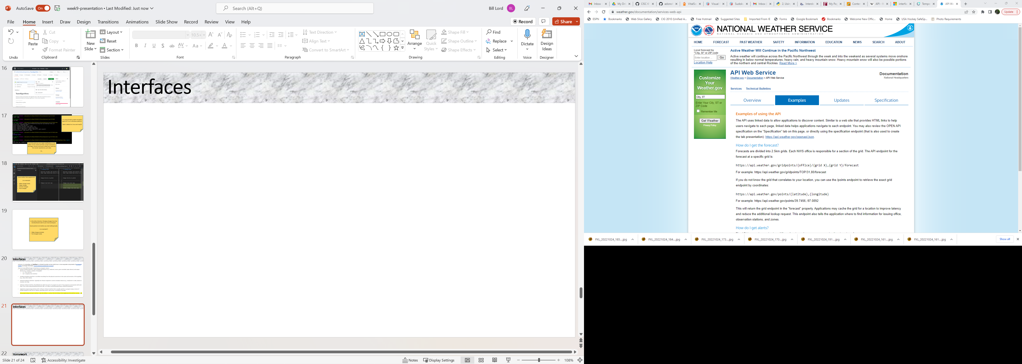
Interfaces
https://api.weather.gov/gridpoints/TOP/31,80/forecast
https://api.meteomatics.com/2022-11-01T00:00:00Z--2022-11-04T00:00:00Z:PT1H/t_2m:C,t_20m:C,t_100m:C,t_200m:C,t_500m:C,t_850hPa:C,t_700hPa:C/48.8566,2.3522/html

Slide 38
Interfaces
APIs
Meteomatics.com
Meteomatics.com Interface Implementation
Your program
Interface definition
SetTime(…)
SetLocation()
GetTemp()
GetHumidity()
.
.
.
Weather.gov Interface Implementation
APIs
Weather.gov

Slide 39
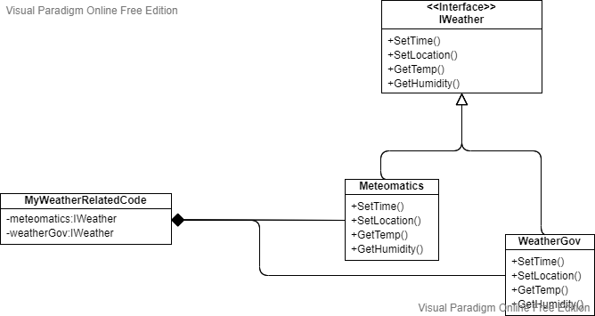
Interfaces
APIs
Meteomatics.com
APIs
Weather.gov

Slide 40
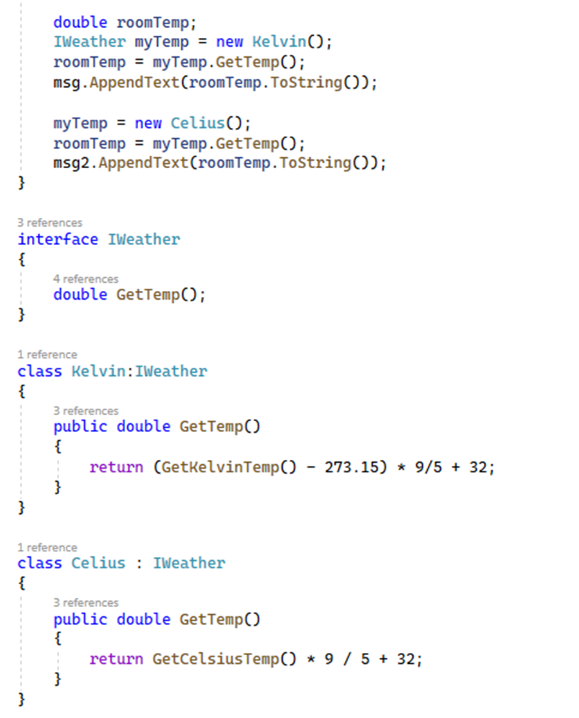
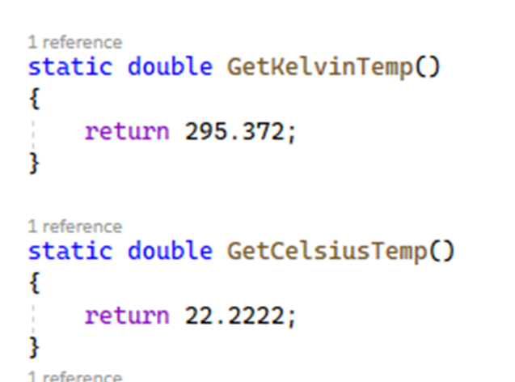
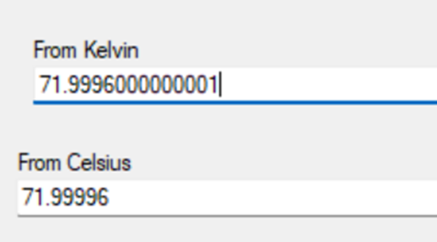
Interfaces

Slide 41
Interfaces
APIs
static double GetKelvinTemp()
{
return 295.372;
}
class Kelvin:IWeather
{
public double GetTemp()
{
return (GetKelvinTemp() - 273.15) * 9/5 + 32;
}
}
Your program
double roomTemp;
IWeather myTemp = new Kelvin();
roomTemp = myTemp.GetTemp(); msg.AppendText(roomTemp.ToString());
myTemp = new Celius();
roomTemp = myTemp.GetTemp(); msg2.AppendText(roomTemp.ToString());
Interface definition
Interface IWeather
{
double GetTemp();
}
class Celius : IWeather
{
public double GetTemp()
{
return GetCelsiusTemp()*9/5 + 32;
}
}
APIs
static double GetCelsiusTemp()
{
return 22.2222;
}

Slide 42
INTERFACE
INTERFACE
INTERFACE
Asynchronous

Slide 43
Frameworks

Slide 44
Full stack development:
Database
Internet
Browser
Server
File system

Slide 45
Types of websites and servers:
Static website
Each page is created from predefined content using HTML, CSS, and/or JavaScript
Every access by every user will see the exact same content
Hosting static website content is just a matter of saving all possible web pages that can be accessed via links
Database access is not required
Dynamic website
Pages can be created ‘on the fly’ on the server based on user input or settings (e.g. Cookies)
Queries can be made to dynamically modify pages on either the client or server side
Different users or the same user at different times may see different content
Hosting dynamic website content can require both database and filing system access
Hybrid website
Uses both static and dynamic content
Servers support storing static content and generating dynamic content
https://www.wix.com/blog/static-vs-dynamic-website

Slide 46





Static servers:
Internet
Amazon S3 (Simple Storage Service)
Browser
Server
File system

Slide 47





Dynamic Servers:
Database
Internet
Browser
Server
File system
SiteGround

Slide 48
Frameworks:
A web framework (WF) or web application framework (WAF) is a software framework that is designed to support the development of web applications including web services, web resources, and web APIs. Web frameworks provide a standard way to build and deploy web applications on the World Wide Web. Web frameworks aim to automate the overhead associated with common activities performed in web development. For example, many web frameworks provide libraries for database access, templating frameworks, and session management, and they often promote code reuse.^{[1]} Although they often target development of dynamic web sites, they are also applicable to static websites.
https://en.wikipedia.org/wiki/Web_framework
Database
Internet
Browser
Server
File system

Slide 49
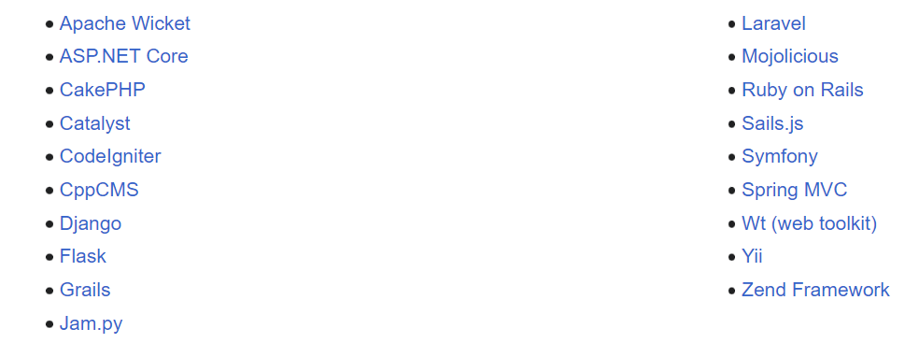
Frameworks:
Client-side:
Backbone.js
AngularJS
Angular
EmberJS
ReactJS
jQuery UI
Svelte
Vue.js
https://en.wikipedia.org/wiki/Web_framework
Server-side:
https://en.wikipedia.org/wiki/Web_framework

Slide 50
MEAN Stack
MongoDB – Database
Express(.js) – Node.js web framework
Angular(.js) – Client-side JavaScript (full fledged) framework
Node(.js) – JavaScript web server
Database - MongoDB
Internet
Browser
(Angular.JS)
Server – Node.JS
(Express.JS)
File system
MERN Stack
MEVN Stack
MongoDB – Database
Express(.js) – Node.js web framework
React(.js) – Client-side JavaScript UI library
Node(.js) – JavaScript web server
MongoDB – Database
Express(.js) – Node.js web framework
Vue(.js) – Client-side JavaScript progressive framework (e.g.: enhanced HTML)
Node(.js) – JavaScript web server

Slide 51
LAMP Stack
Linux – Operating System
Apache – Web server
MySQL – Database
PHP – Scripting language (run on server-side, but generates client-side HTML code)
Database - MySQL
Internet
Browser
(HTML)
Server – Linux/Apache
(PHP)
File system

Slide 52
My Stack
Database - MySQL
Internet
Browser
(HTML, CSS, JavaScript)
Server – Django
(Django/Python)
Windows

Slide 53
Factors in choosing:
Server:
Performance required
Number of pages to serve
Speed of response
Anticipated traffic
Up time
Static, dynamic, or hybrid
Support available
Development and deployment tools
Human support
Documentation
Security
Cost
Framework(s):
Language(s) supported
Types of applications anticipated
Ease of use
Compatibility with server
Compatibility with other frameworks to use
Documentation
Cost

Slide 54
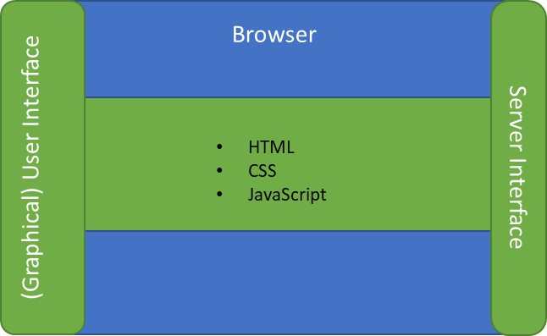
Next major team task: Decide on your stack * To be started now and finished by next class * Next class each team will present their decisions
Database
Name?
Language?
Internet
Graphical User Interface
(view)
Sudoku engine
(controller)
Browser
Server
http request
Encoding?
Sudoku representaton
(model)
Sudoku algorithms
Server name?
Language?
Languages?
http response
Encoding?

Slide 55
Project Specifics

Slide 56
Project Specifics: Deliverables
As a team
Storyboard
Use case diagram
Project plan
Tasks with dates, dependencies, and resources (team members)
Keep changes up-to-date
Keep progress tracking up-to-date
Testing plan
Component testing
System testing – including performance testing
Testing results
Keep all testing code in final code deliverable
Document results of system testing
Class diagram (and sequence and / or activity diagrams as appropriate)
Bi-weekly status reports
Progress versus project plan
Final presentation
Storyboard
Architecture
Demonstration
Testing results
Access to your code/document repository
Individually
Interface documentation for your coding modules
Unit testing results for your coding modules
Your code
Description of your contributions
Distribution of work …

Slide 57
Distribution of work
Select an individual to
Draw decided upon storyboard
Draw decided upon use case diagram
Create and maintain project plan
Tasks with dates, dependencies, and resources (team members)
Keep changes up-to-date
Keep progress tracking up-to-date
Create and maintain test plan document (from input by all team members)
Create and maintain testing results (from input by all team members)
Class diagram (but with content specified by all team members)
Puzzle
History
Bi-weekly status reports (rotate among team members)
Progress versus project plan
Set up GitHub for use by whole team
Server API documentation (from specifications by whole team)
Render the GUI
Program the HTTP interface
Browser side
Server side
Set up and maintain the database
Individually
API documentation for your coding modules
Unit testing results for your coding modules
Sequence and / or activity diagrams as appropriate
>= 1 GUI tasks
>= 1 Server tasks
A part of the final presentation
Your plan for distribution of work should strive to achieve equal time and effort by all team members by dividing the work equitably.

Slide 58
How to manage/organize/run a project

Slide 59
Project
Suggestions for getting started:
Identify someone to ‘run’ meetings (keep chaos at a minimum)
Difficult task!
You are all peers (equals), there is no ‘senior’ person
You are not in a position of authority
Rotate this role through all team members
Set meeting goals
Set an agenda
Work for consensus (when possible)
Get everyone’s involvement

Slide 60
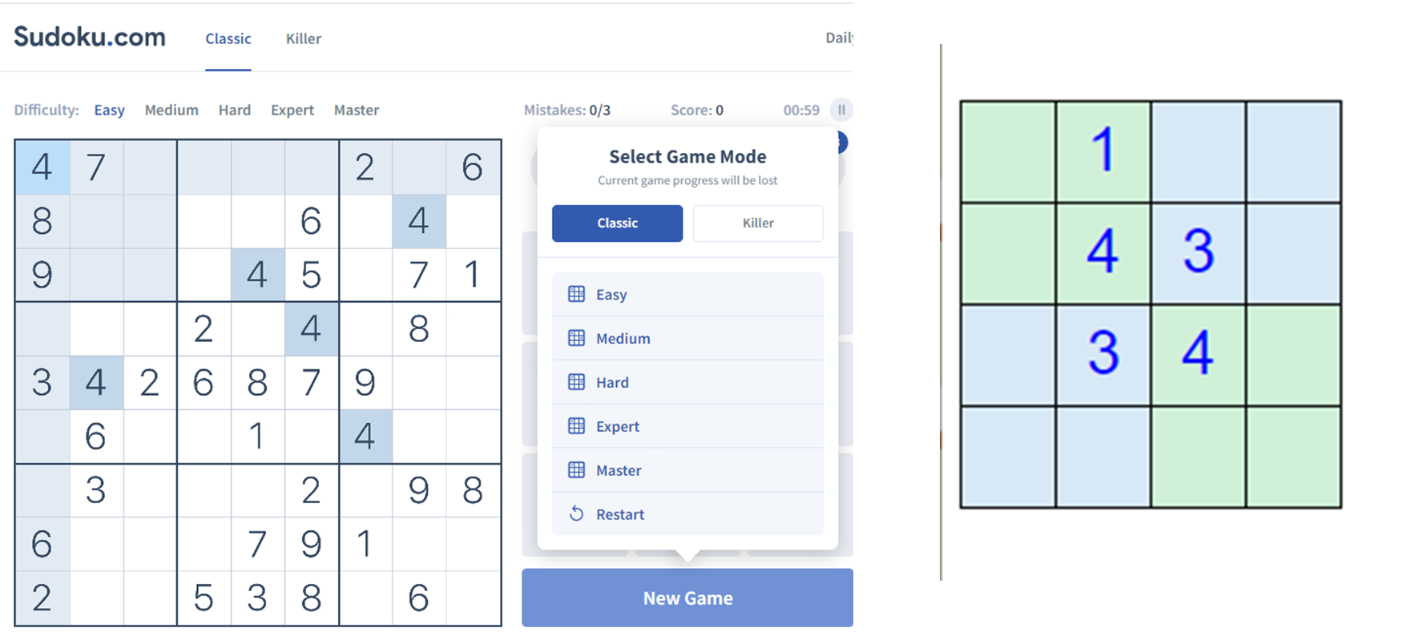
Project
Suggestions for getting started:
Create/look up 3 9x9 games (easy, medium, hard) and 1 4x4 game to put in your database

Slide 61
Project
First steps after ‘Getting Started’
Confirm that your storyboards facilitate all the required functionality
Use / create sequence and activity diagrams as needed
Focus on the transfer of information

Slide 62
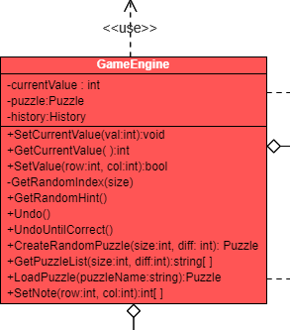
Project
First steps after ‘Getting Started’
Identify all required modules and assign team members to each
For each module identify all data structures and functions (or classes if using OOP)
Document all publicly accessible data structures and functions (or public methods if using OOP)
Class diagram
API document

Slide 63
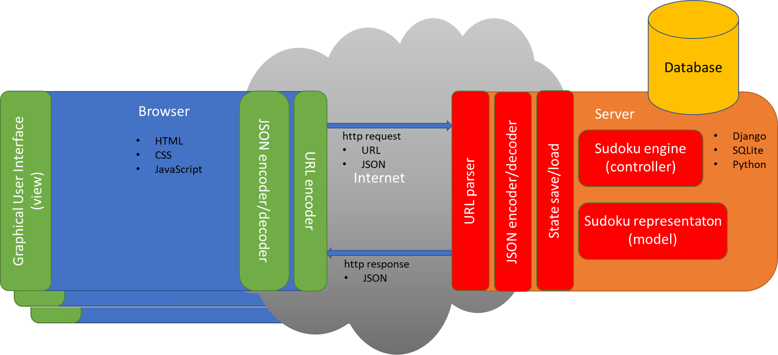
Project
First steps after ‘Getting Started’
Determine all required interfaces
Front-end to back-end interface
Request and response
Payload encoding (JSON)
Back-end to database interface
Entity Relationship Diagram (ERD)
APIs or native access

Slide 64
Project
Ways to submit the project:
Best case scenario: Group to submit a link to a GitHub or similar repository (full credit)
Include a folder/directory for each individual’s non-code contributions
Include a code folder with sub-folders for each individual’s code contributions and integration and testing code
Include a folder for group results
Medium case scenario: As above but submitting via a zip file (minus 2%)
Worst case scenario: (minus 5%)
Each individual submits own work
One group member submits integrated work

Slide 65
Homework

Slide 66
Homework
To be completed as a team
Class diagram (two-week assignment due next class)
Update your project plan to include new details
Breakdown of major task into individual tasks
Assignment of primary contributor to each task
Estimated start and completion dates for each task
Fill in the diagram on the next slide and include the name of the full stack you are using (if any)
Present your team’s full stack decision and your updated project plan

Slide 67
Database
Name?
Language?
Internet
Graphical User Interface
(view)
Sudoku engine
(controller)
Browser
Server
http request
Encoding?
Sudoku representaton
(model)
Sudoku algorithms
Server name?
Language?
Languages?
http response
Encoding?

Slide 68
Software Architecture

Slide 69
Software architecture
Software architecture refers to the fundamental structures of a software system and the discipline of creating such structures and systems. Each structure comprises software elements, relations among them, and properties of both elements and relations. https://en.wikipedia.org/wiki/Software_architecture
From https://www.redhat.com/architect/what-is-software-architect one of the 12 skills required of a software architect:
Unified Modeling Language (UML) is often listed as an essential requirement. What is certainty essential is familiarity with diagramming complex architectures
Much of the information on the following slides is from Chapter 10 in our book:
Pressman, Roger. Software Engineering: A Practitioner's Approach. Available from: VitalSource Bookshelf, (9th Edition). McGraw-Hill Higher Education (US), 2019.

Slide 70
Software architecture
Architecture design is information driven
Data
Functional
Behavioral

Slide 71
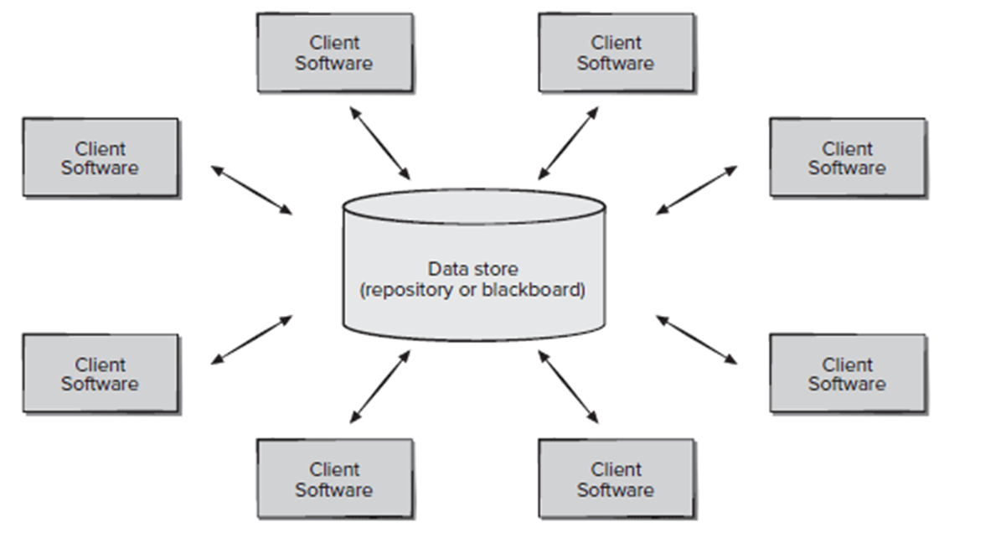
Software architecture
Data-centered architecture:
Independent clients – can be added, deleted, or modified without effecting others
Communication can take place via the data store
Examples: ???

Slide 72
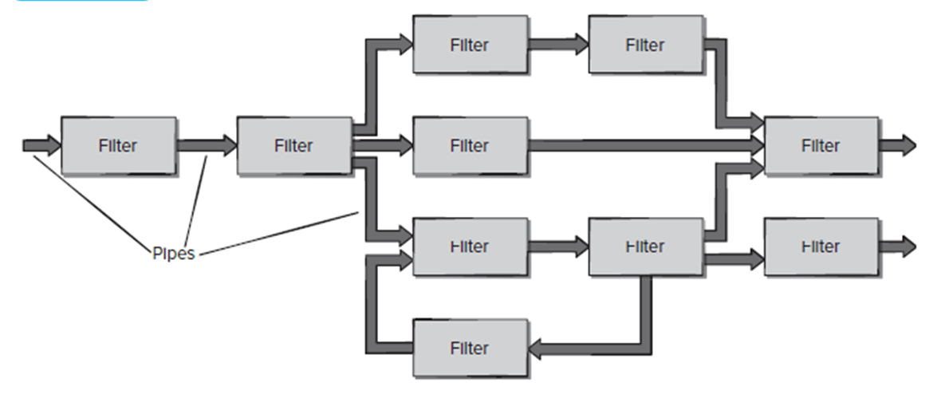
Software architecture
Data-flow architecture:
Asynchronous processing of data
Raw data into information
Examples: ???

Slide 73
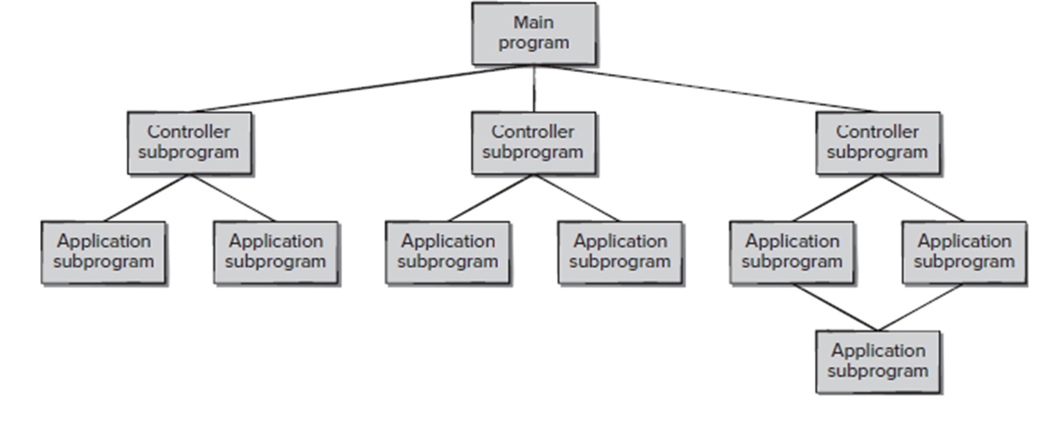
Software architecture
Main program/subprogram architecture:
Synchronous processing
Can be all in one program on one computer
Can be distributed across multiple computers using:
Remote Procedure Calls (RPCs)
Examples: ???

Slide 74
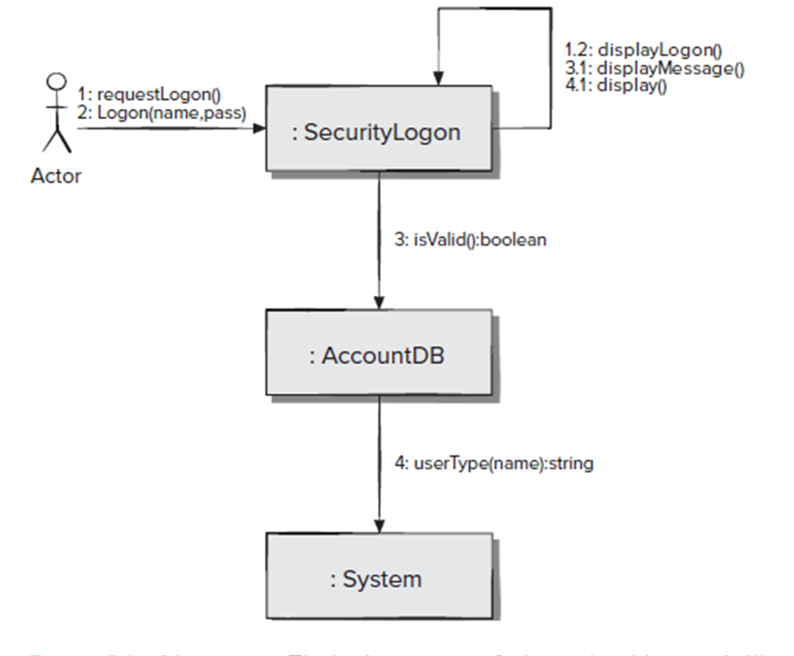
Software architecture
Object-oriented architecture:
(In my mind) similar to main program/subprogram architecture, but using object-oriented programming techniques
Examples: ???

Slide 75
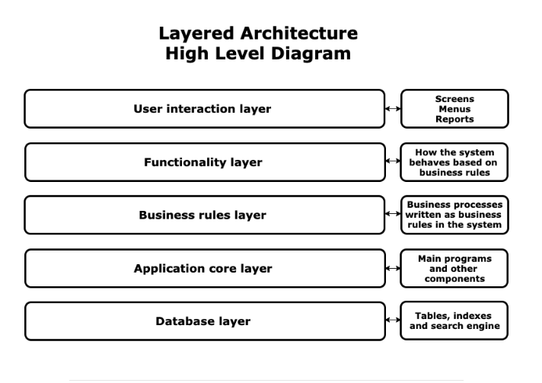
Software architecture
Layered architecture:
Separation of concerns into layers
Examples: ???
https://openclassrooms.com/en/courses/6397806-design-your-software-architecture-using-industry-standard-patterns/6896176-layered-architecture#:~:text=Gmail%20is%20divided%20into%20at,example%20of%20a%20layered%20architecture.

Slide 76
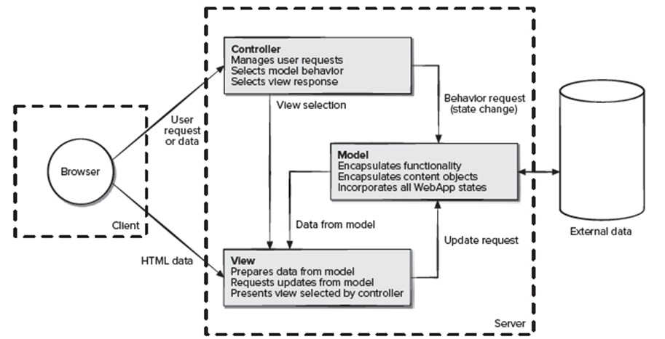
Software architecture
Model-View Controller (MVC) architecture:
Often used in Web development
Examples: Our project! Kinda.

Slide 77
Software architecture
These architectural styles are only a small subset of those available.
Once requirements engineering uncovers the characteristics and constraints of the system to be built, the architectural style and/or combination of patterns that best fits those characteristics and constraints can be chosen.
In many cases, more than one pattern might be appropriate and alternative architectural styles can be designed and evaluated.
For example, a layered style (appropriate for most systems) can be combined with a data-centered architecture in many database applications.

Slide 78
Team time

